Slide 1


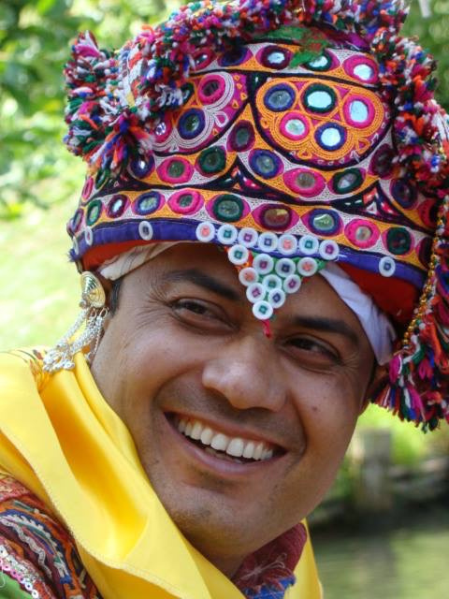

: +918511399355
RANG FOLKLORE
A School of Performing Art of Global Exchange and Gujarat Art Platform
  ABOUT
  INTRODUCTIONS
  OUR VISION
  HONORARY MEMBERS
  OUR PERFORMANCE
  PICTURES
  OUR ACHIEVEMENTS
  OUR AIM
  WELL WISHERS MESSEGE
  PICTURES
Rang Folklore Foundation India
Notes:
1

Slide 2


RANG FOLKLORE
: +918511399355
A School of Performing Art of Global Exchange and Gujarat Art Platform
Member of International Dance Council
Member of International Organization of Folk Art
210, Ganesh Glory , Behind SBI Bank , Near BSNL Bhavan
Jagatpur Road,S.G Highway,Gota Ahmedabad,Gujrat , India:382470
A cool creative group featuring People and understand the unique platform to perform.
WWW.RFFINDIA.COM
Rangfolklorefoundation@yahoo.com
Notes:
1

Slide 3
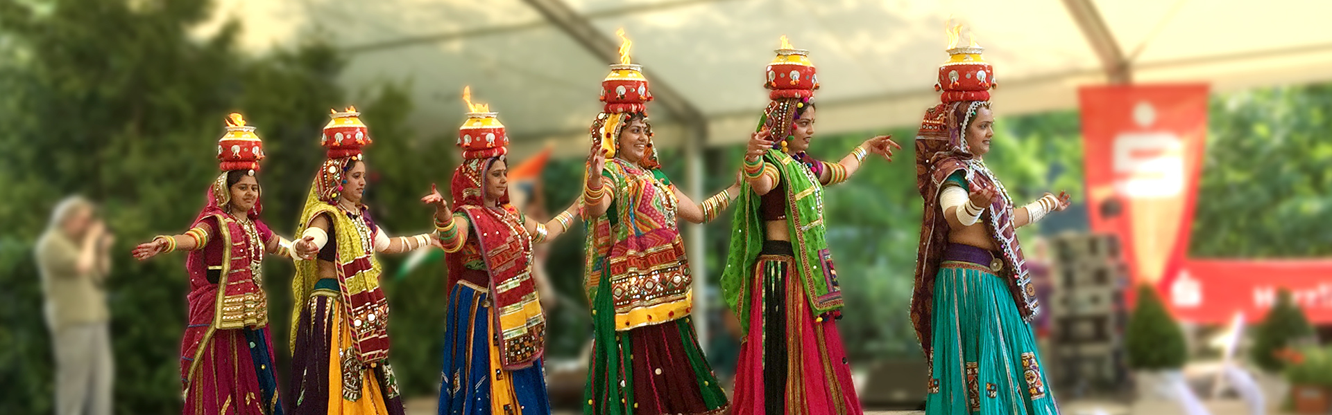
Every child is an artist , The problem is an artist when you growup
-Paolo Picasso
We are happy to introduce our cultural organisation Rang Folklore Foundation – A School of Performing Art of Global Exchange and Gujarat Art Platform with the glorious history of more than four decades. We have contributed in the field of regional cultural.
With the note-worthy progress of the media in recent years, the horizons of entertainment have expanded considerably, and along with this expansion the craving for the cultural exposure has heightened to its peak.
The Indian cultural history of 5,000 years flows through generations as it reflects in immortal folk-dances and folklore, depicting vibrant and vivid patterns. The folk dances of India are generally quite spontaneous and are the creation of the people’s imagination and desire for artistic and emotional expression. Displaying no inclination towards a rigid form, the whole depiction of folk art is guided more by the subject of the songs, which glorify nature, express traditional occupations or offer devotion to the deities.
Notes:
2

Slide 4
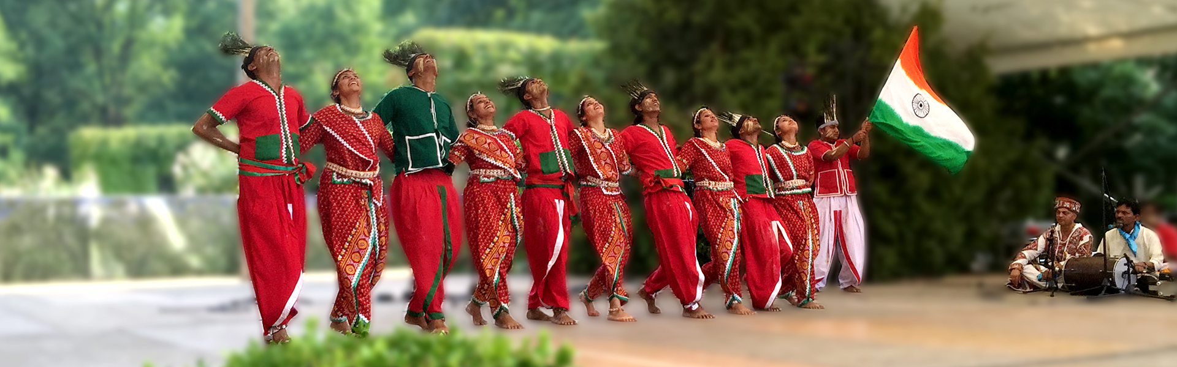
Rang Folklore Foundation [A School of Performing Art of Global Exchange and Gujarat Art Platform] is the expression of that ambition to provide the nicest network. The promoters of this institution have invested at least five decades of their lives to achieve the confidence to speak a few things about our great heritage and to lead the young generation to the world platform with the wealth of that heritage expressed fascinatingly in various forms of performing arts. Among many forms of artistic expression of people’s joy and agony. Rang Folklore Foundation [A School of Performing Art of Global Exchange and Gujarat Art Platform] has concentrated a foot forward, as the first leap on Folk Theatre (BHAWAI) and Folk Dances (RAS-GARBA) for which Gujarat is known from centuries to the rest of India and will be known to the rest of the world in future.
Practical training of these artistic forms is not the full point of the final goal to the runners of Rang Folklore Foundation [A School of Performing Art of Global Exchange and Gujarat Art Platform] Besides acquiring the essence of these art forms in to, the participants are expected to master them so excellently, very rightfully, in their true spirit.
Notes:
3

Slide 5
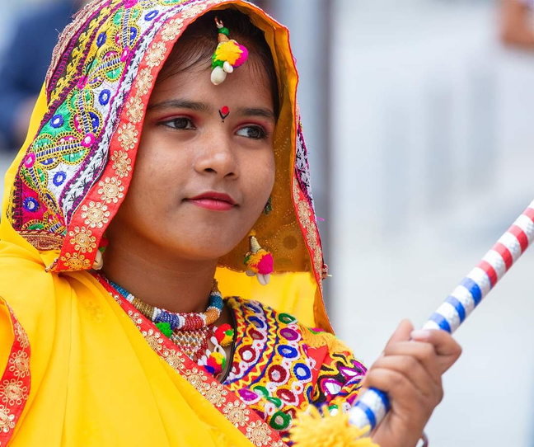
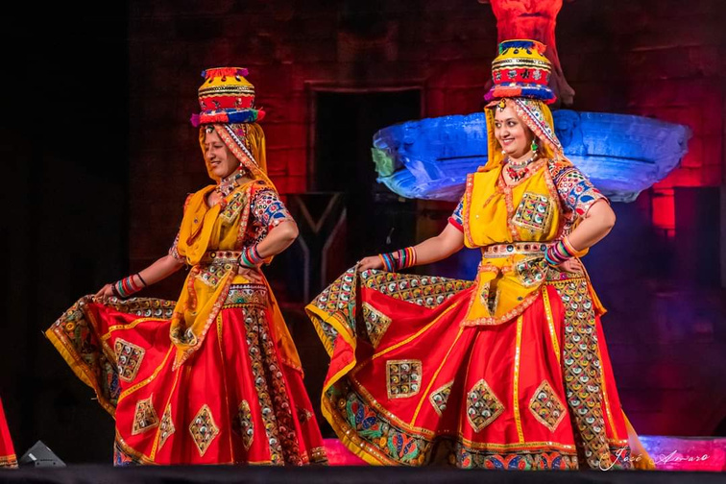
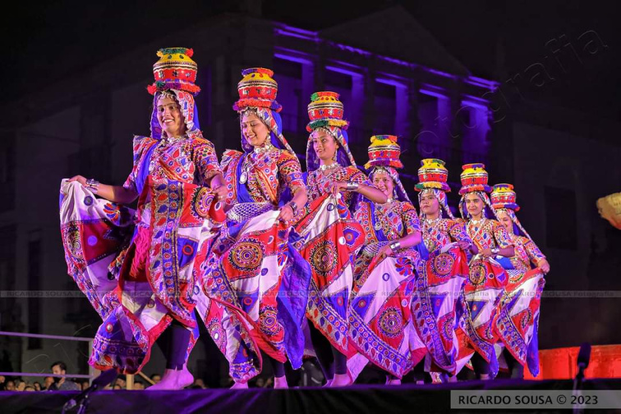
Our Aim
-To promote amateur talent in all the fields of Art-Theater, Dance, Folk Dance, Music , Songs etc.
-To strive for an all round culture development of the artistes.
-To provide a thorough training of body, mind and soul thorough Yoga. Aerobics leadership seminars, dance and music workshops.
-To provide opportunity and prepare young and child amateur artists to display their talents at national and international levels.
-To provide a platform for amateur talents to blossom as professional artists.

Slide 6
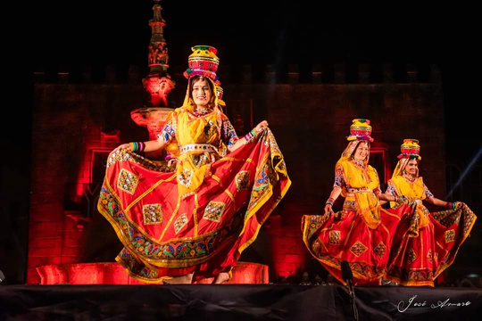
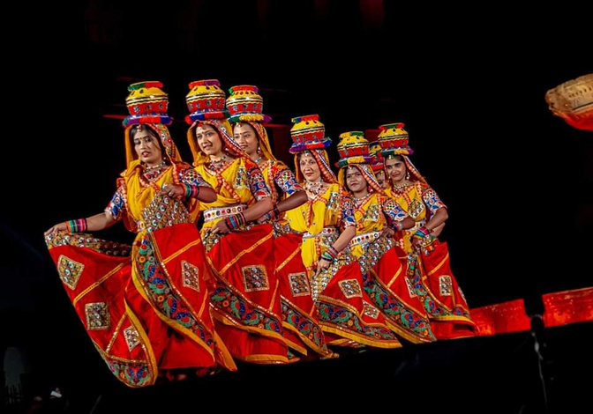
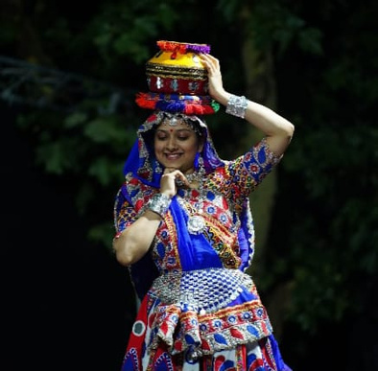
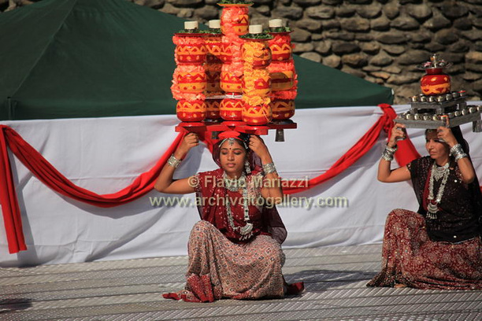
Our Vision
-To strive to install an awareness of the culture and art heritage of our country amongst the society.
-To create and foster a spirit of love, goodwill and friendship amongst the people of the world.
-To participate in international festival in foreign countries and to revive the art, culture and heritage of our country amongst other countries.
-To instill feelings of patriotism in our youth and better international understanding through travel and culture exchange.
-To provide an opportunity of a life time, am unique experience of meet artists of the world on a common platform at international children Folk Dance and Drama festival.

Slide 7

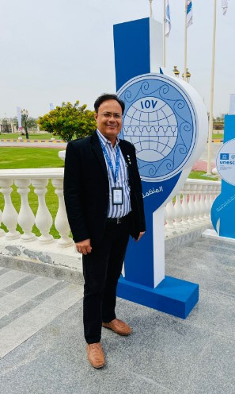
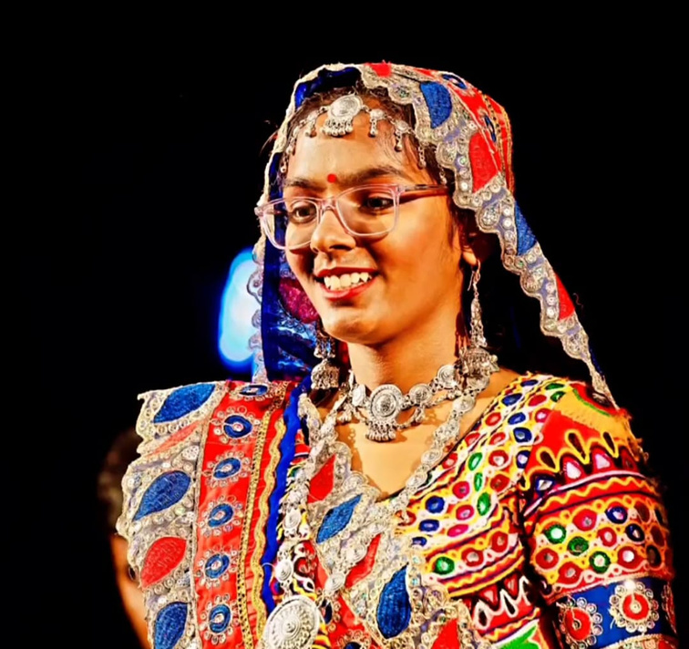


Slide 8
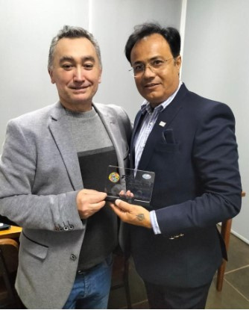
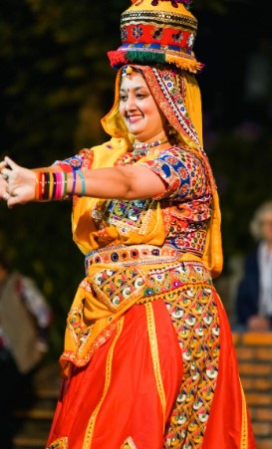
YEAR :: 2023 TO 2016
2023
WGA Meeting with The International Organization of folk Art ( IOV ) UAE Sharjah March 2023 https://www.iov.world/11462-2/
Personal Meeting with Folk Cantanhede Semana International de Folklore May 2023 Portugal (CIOFF)
Personal Meeting with Council of International dance (CID ) France May 2023
International Festival Cantanhede Semana International de Folklore 2023 Portugal ( CIOFF)
International Folk Dance Festival Viana do Castelo 2023 Portugal (CIOFF)
International Folk Dance FESTIFOLK FESTIVAL INTERNATIONAL DE FOLCLORE “CIDADE DE PONTE DE SOR” 2023 PORTUGAL (CIOFF)
2022,2021,2020,2019 Covid 19
Japan visit to meeting with folklore group
2018
2017
International Folk Dance Festival [ Moscow]
International Folk Dance Meeting [ Japan ]
2016
IOV International Folk Dance Festival [Hungary]
Nemzetkozi Neptanc gala 2016 Zalabzentgrot [ Hungary ]

Slide 9
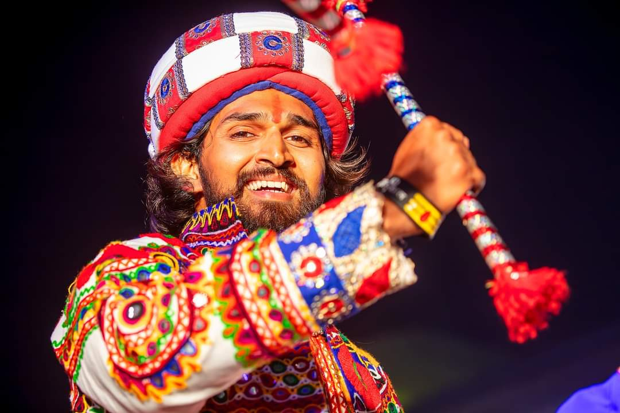
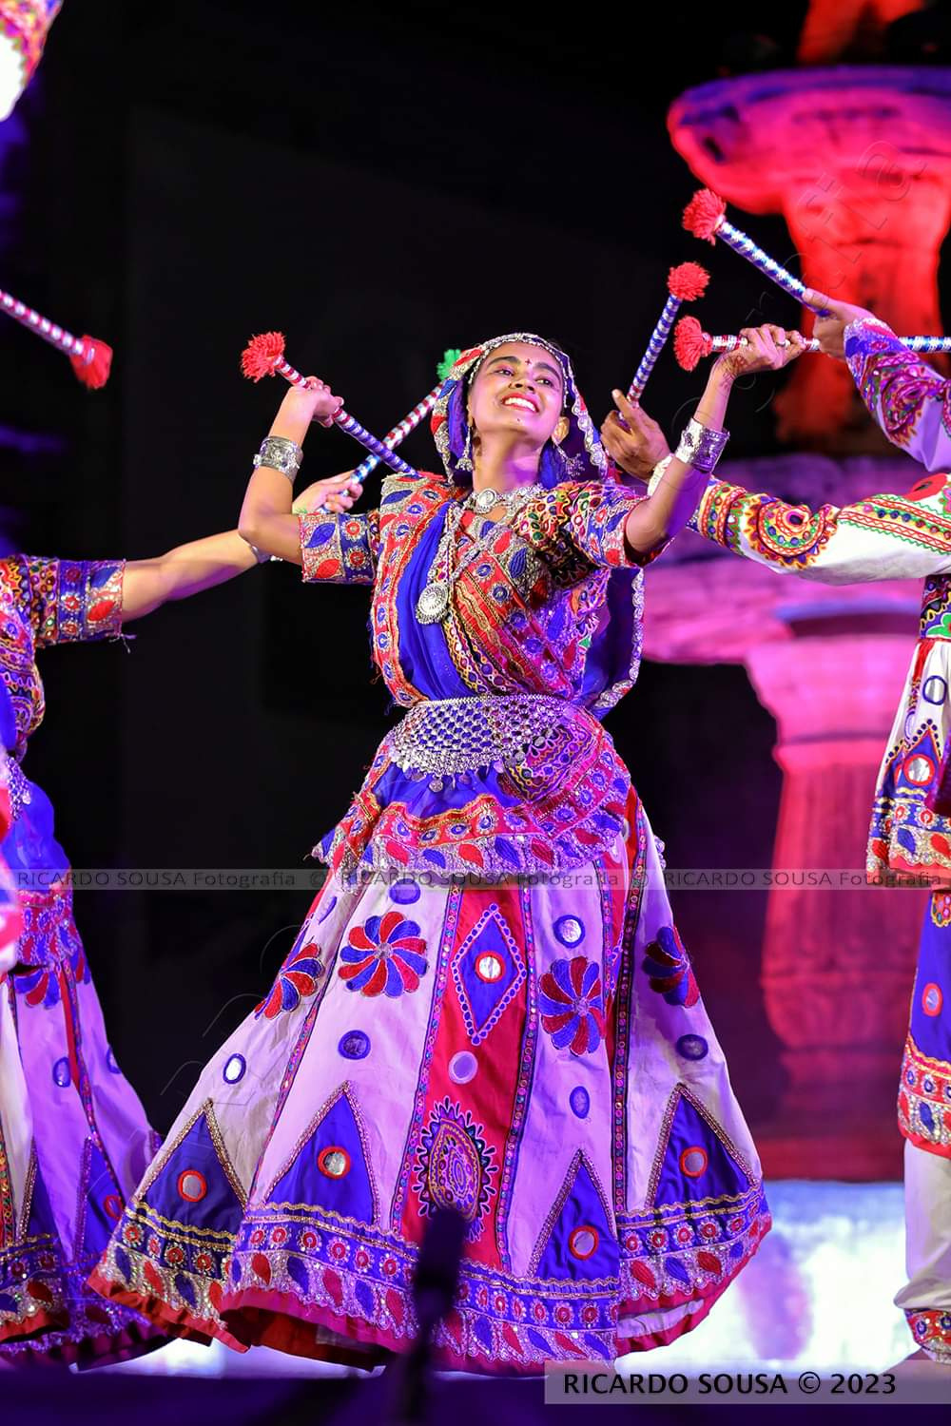
YEAR :: 2011 TO 2015
2015
Folk Dance Festival [Cottbus - Germany]
Folk Dance Festival [Lusatia - Germany]
2014
Folk Dance Festival [Rimine - Italy]
Folk Dance Festival [Troppea - Italy]
2013
Folk Dance Festival [Pinda de Mar - Spain]
Folk Dance Festival [Metallica - Italy]
2012
Folk Festival - Nov. [Praha]
Folk Festival - Sep.[Romania]
Folk Festa Festival [Nysa - Poland]
Malta International Folk Festival [Malta]
International Folk Dance Festival [Germany]
International Folk Festival Dukat Fest [Bosnia And Herzegovina]
2011
Malta International Folk Festival [Malta]
International Folk Dance Festival [Germany]
International Folk Festival Dukat Fest [Bosnia And Herzegovina]
World Folk Dance Festival [Spain]

Slide 10
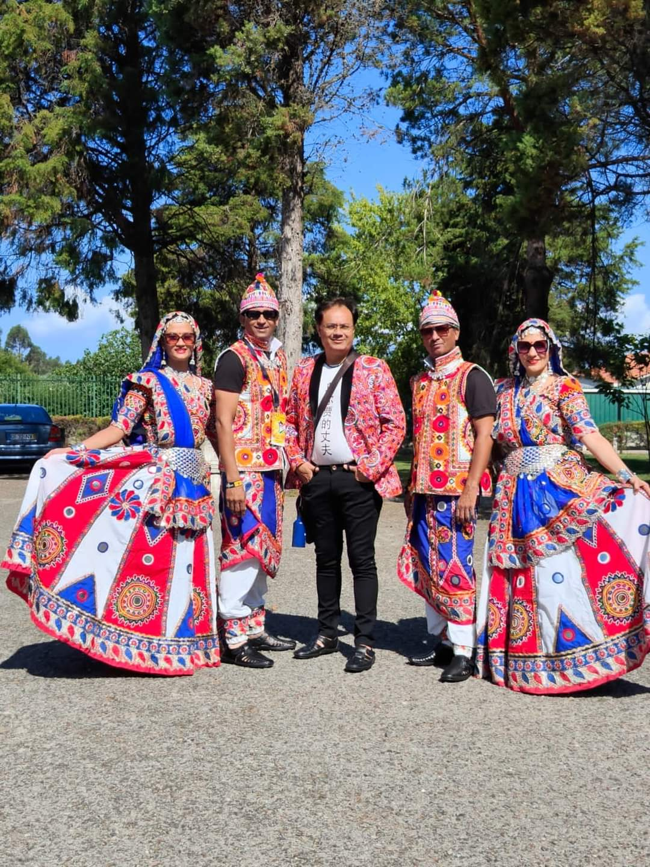
YEAR :: 2006 TO 2010
2010
Associazione Prosusa [Italy]
Cultural Association "Iov Italia" [Italy]
International Culture And Art Festival [Turkey]
Yesilkoy Folk Dances Festival [Turkey]
2009
International Folkmoot Festival [USA]
International Festival Organizing Committee [Portugal]
International Folklore Festival [Germany]
2008
To attend the first IOV World Youth Congress Meeting [USA]
Festival Internacional De Folclore [Portugal]
Navratri Festival (9 days Regional Folk Festival) [Siddhpur, Mehsana, Ahmedabad - India]
2007
International Folklore Festivals Foundation [Bulgaria]
Navratri Festival (9 days Regional Folk Festival) [Siddhpur, Mehsana, Ahmedabad - India]
2006
International Folklorelawine [Germany]
Member of International Organization of Folk Art [IOV]
Navratri Festival (9 days Regional Folk Festival) [Siddhpur, Mehsana, Ahmedabad - India]

Slide 11
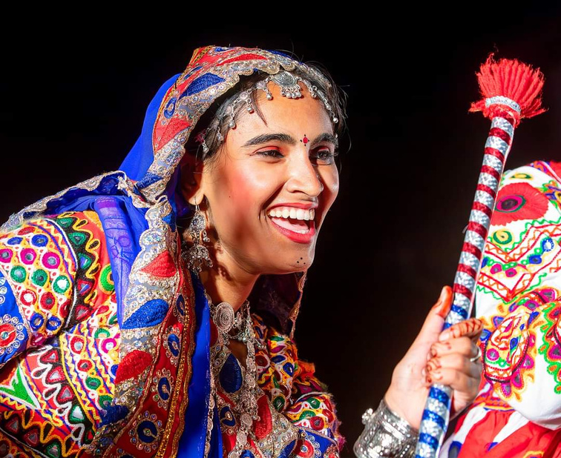
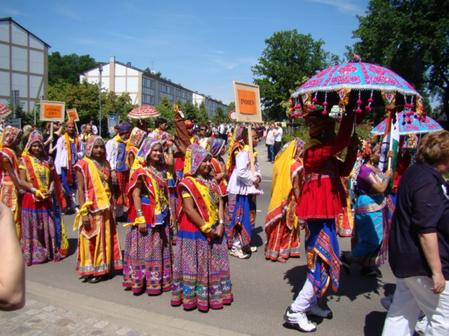
YEAR :: 2001 TO 2005
2005
23ʳᵈ Festival International De Musica De Cantonigros [Spain]
Navercales Village Mayor & old people house performance
Navratri Festival (9 days Regional Folk Festival) [Siddhpur, Mehsana, Ahmedabad - India]
2004
International Folk Festival [Croatia]
Navratri Festival (9 days Regional Folk Festival) [Siddhpur, Mehsana, Ahmedabad - India]
2003
22ⁿᵈ Festival International De Musica De Cantonigros [Spain]
Member of Conseil International De La Dance [Unesco]
2001
To visited to Federazione Italiana Tradizioni Populari [Italy]

Slide 12

YEAR :: 1996 TO 2000
2000
Youth Festival for Indian Society of Kenya [An Indian Society Program]
1999
Youth Festival De Las Cultures Del Mundo [Lima - Peru]
1998
Uttar Gujarat Folk Dance Festival [Siddhpur - India]
1997
Children Festival Folklore Enafants De Monde [Quebec - Canada]

Slide 13
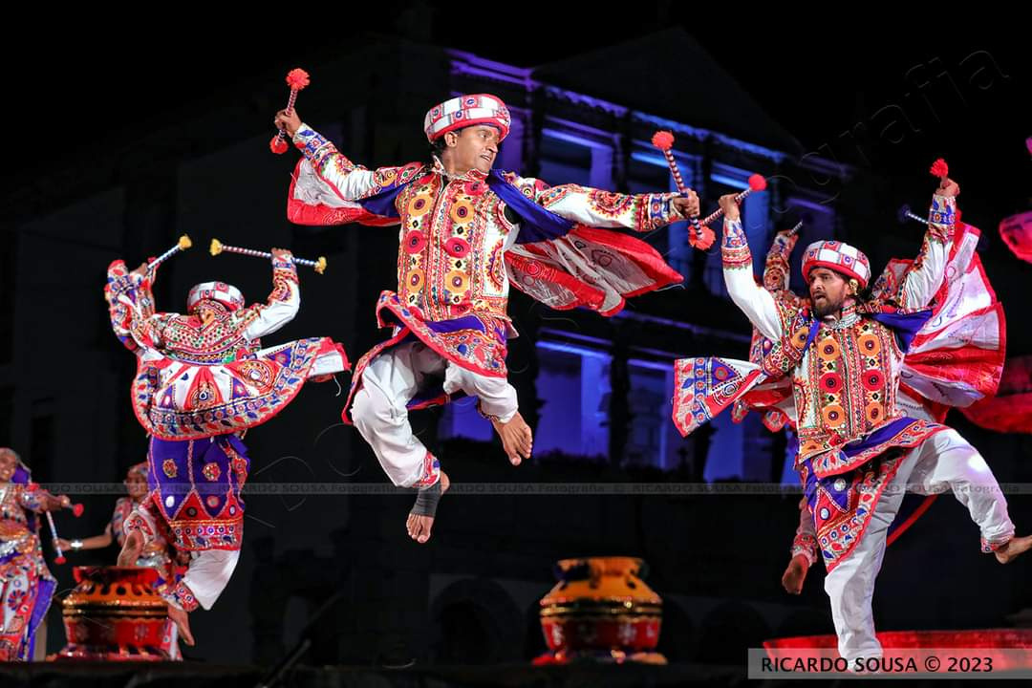
YEAR :: 1991 TO 1995
1995
Navratri Festival (9 days Regional Folk Festival) [Siddhpur, Mehsana, Ahmedabad - India]
1992
Uttar Gujarat Folk Dance Festival [Unjha - India]

Slide 14
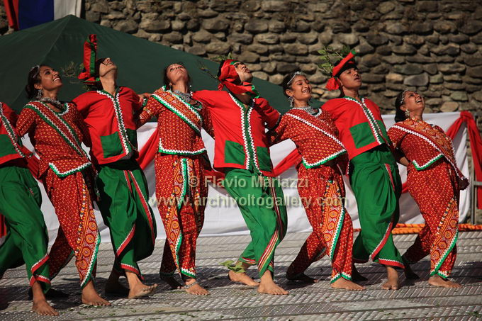
YEAR :: 1985 TO 1990
1989
Navratri Festival (9 days Regional Folk Festival) [Siddhpur, Mehsana, Ahmedabad - India]
1988
Youth Festival for Folk Dance Festival [Mehsana - India]
1987
Uttar Gujarat Folk Dance Festival [Unjha - India]
1985
Establishment To every year we make Regional Folk Dance Festival – Siddhpur at our home town "Navratri Festival" [India]

Slide 15
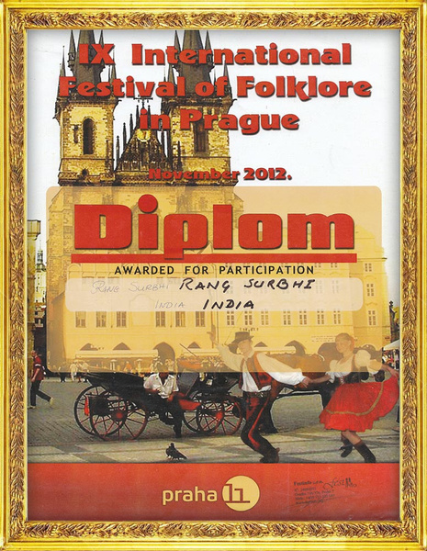
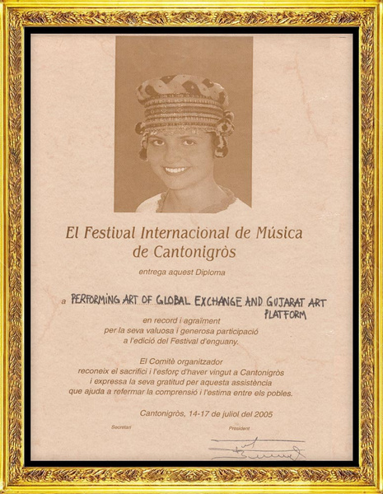
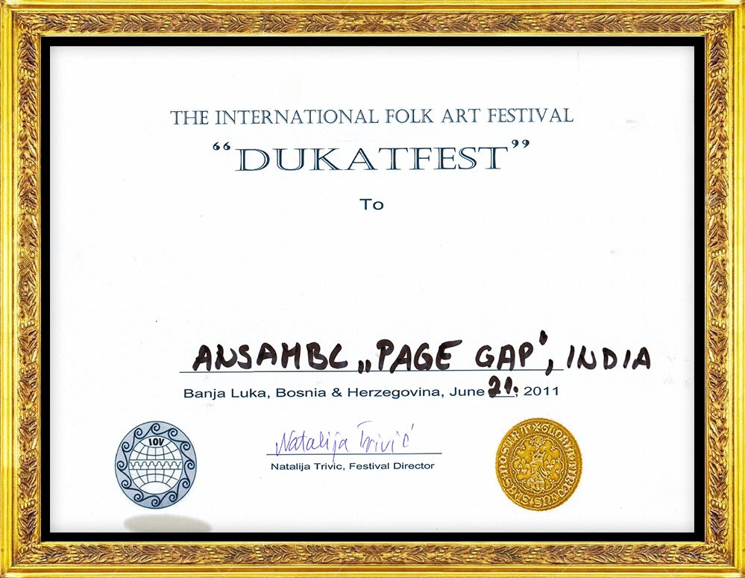

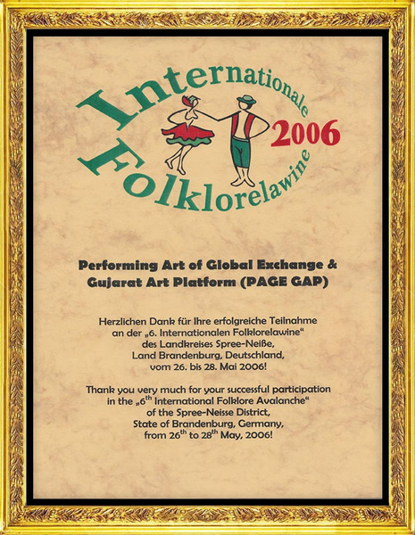
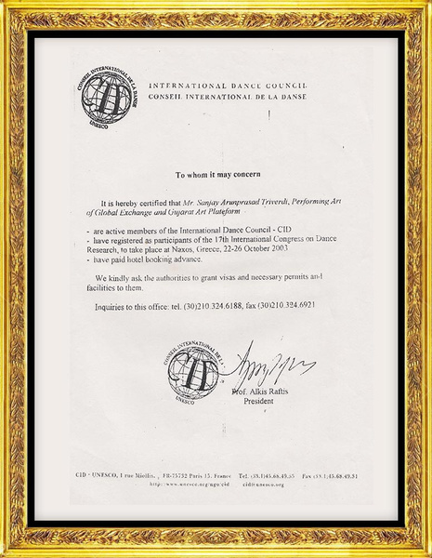
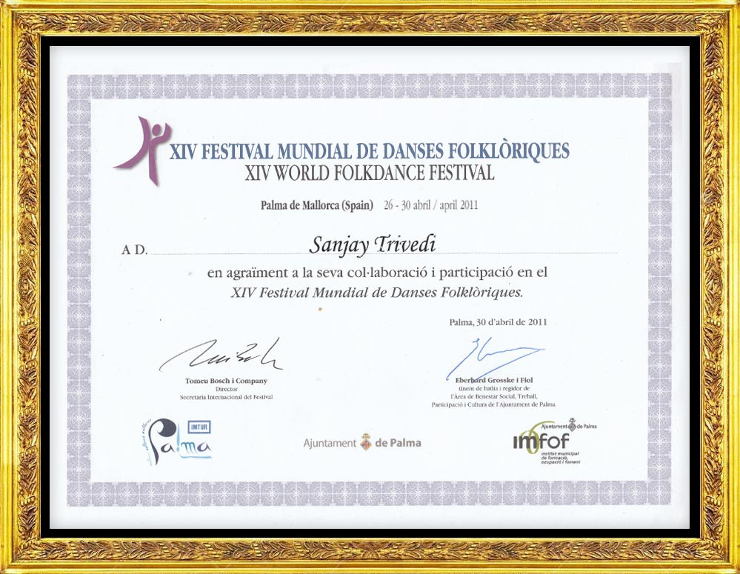
OUR ACHIEVEMENTS

Slide 16
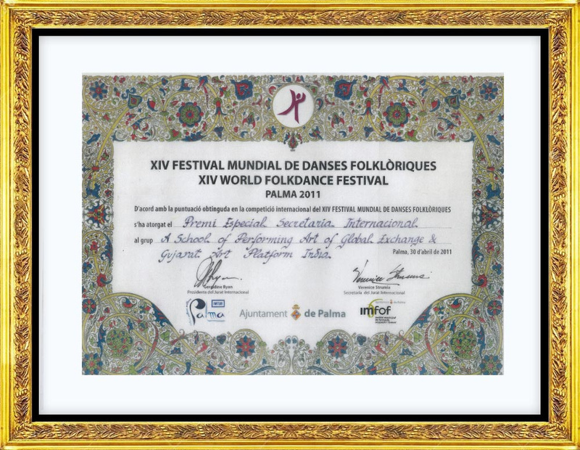
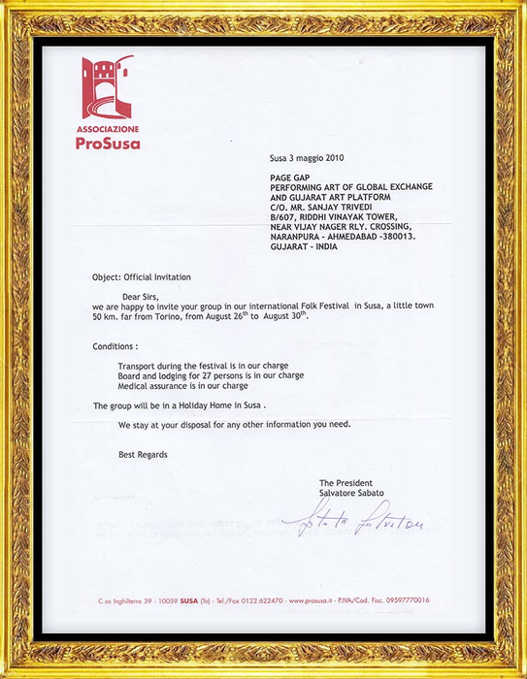
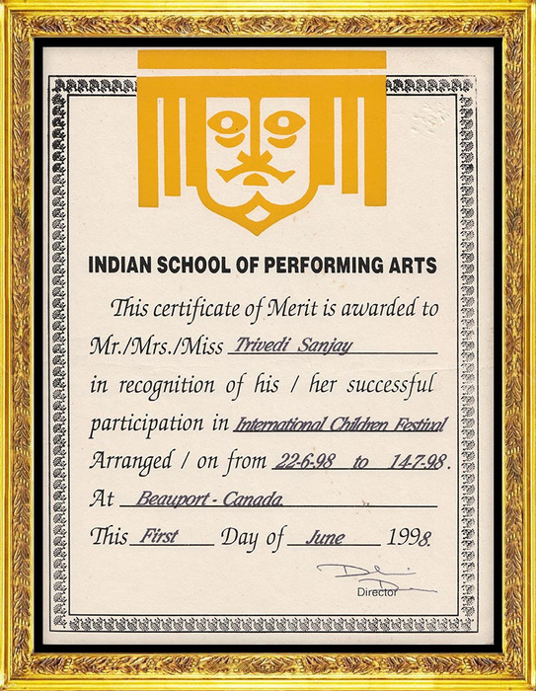
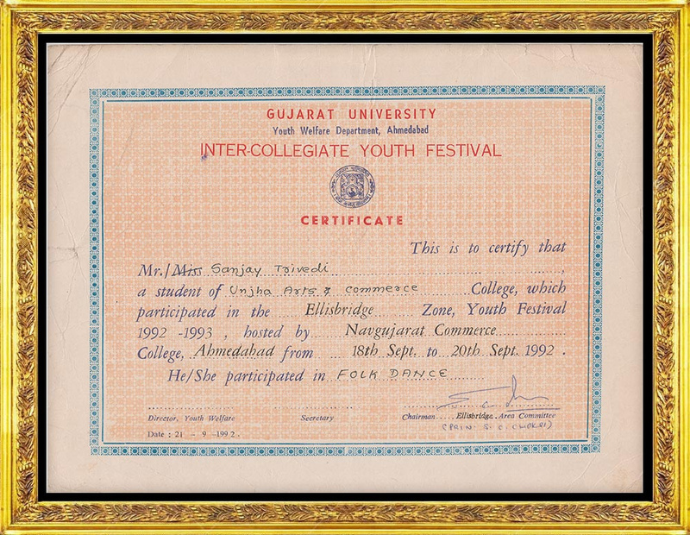
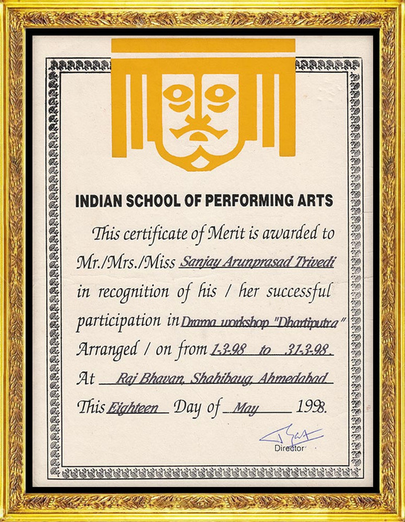
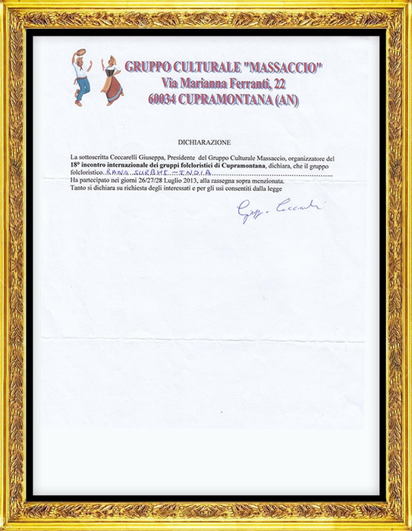

Slide 17
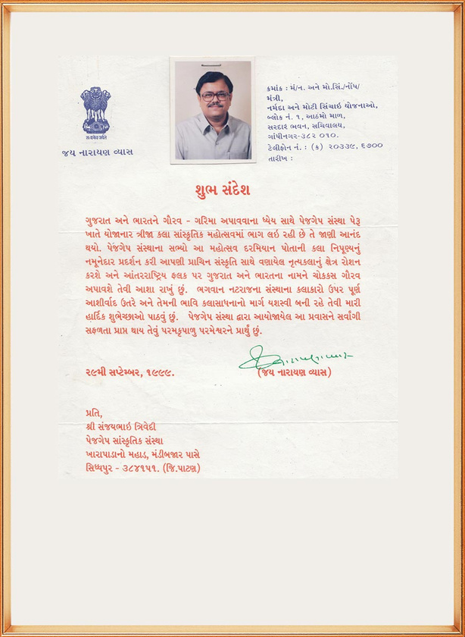
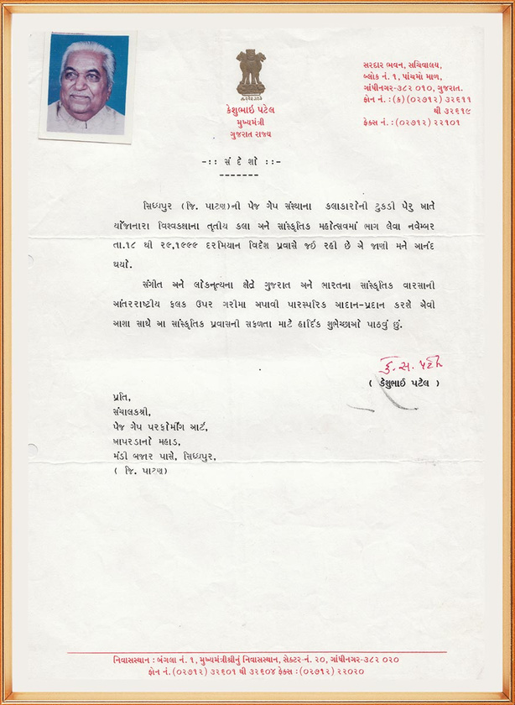
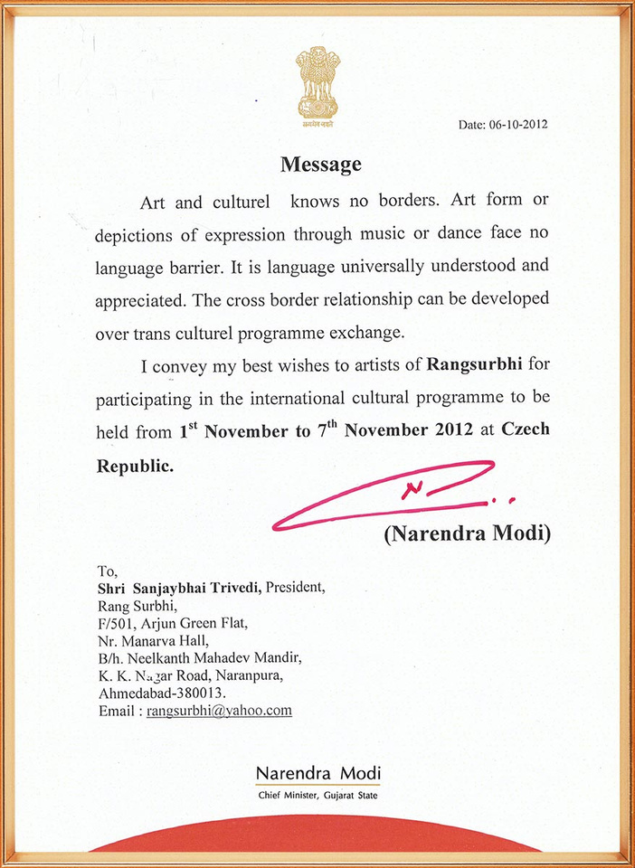
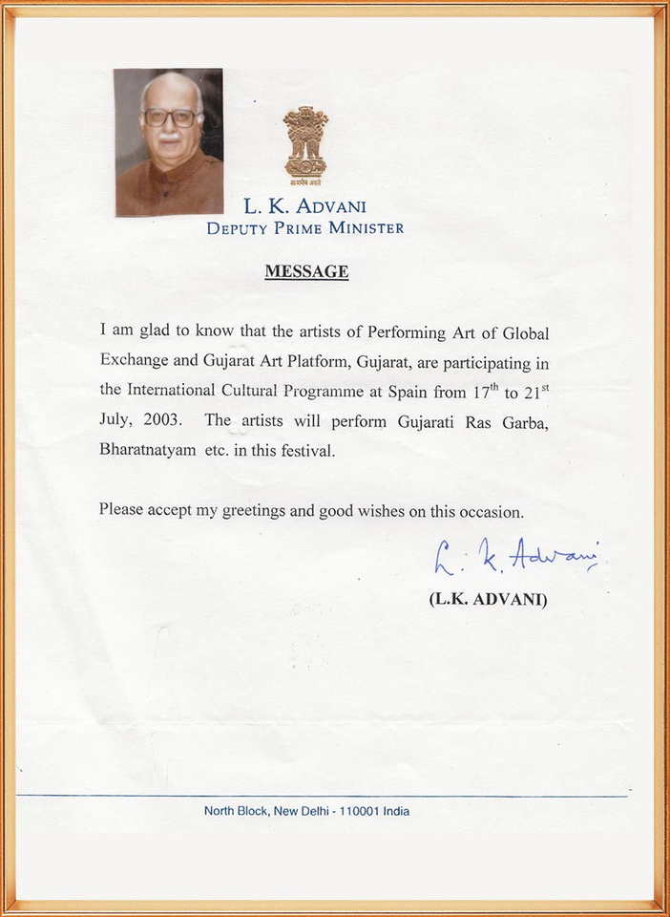
well wishers
message

Slide 18
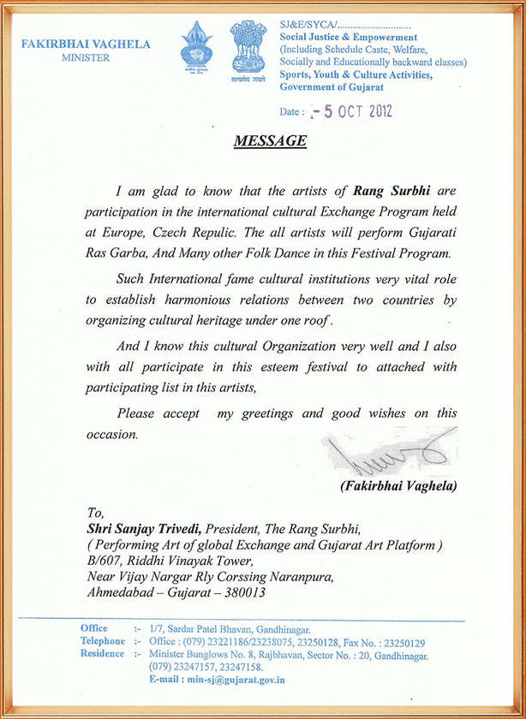
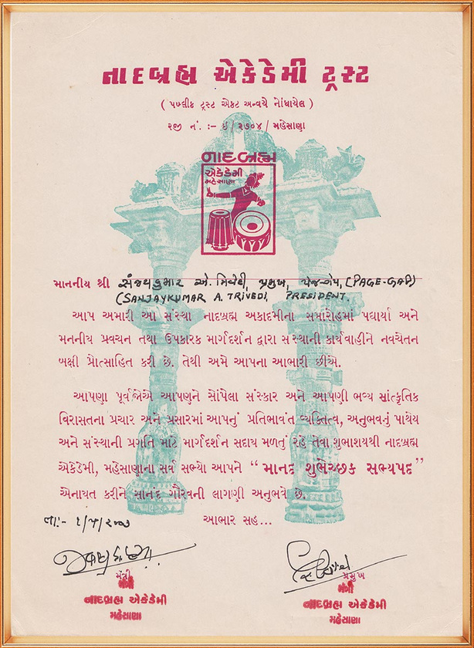
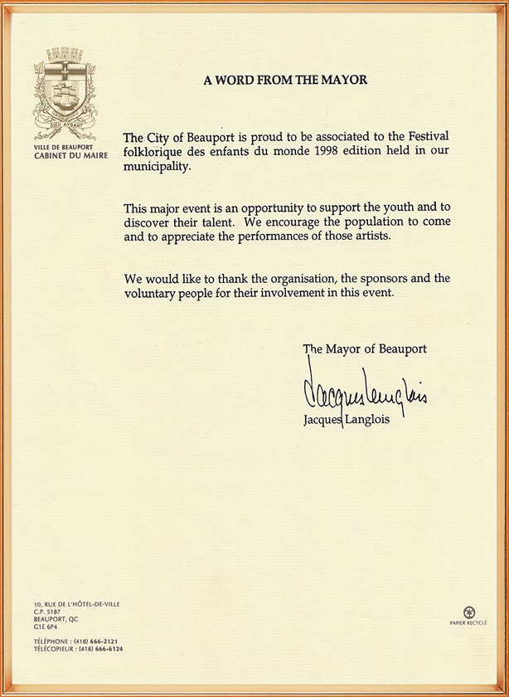
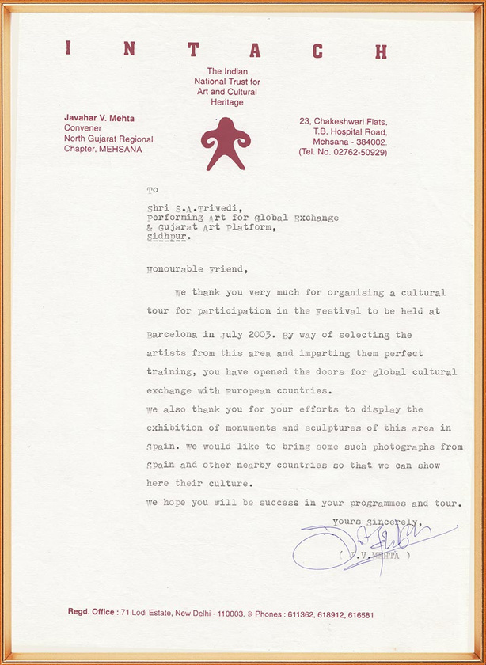

Slide 19
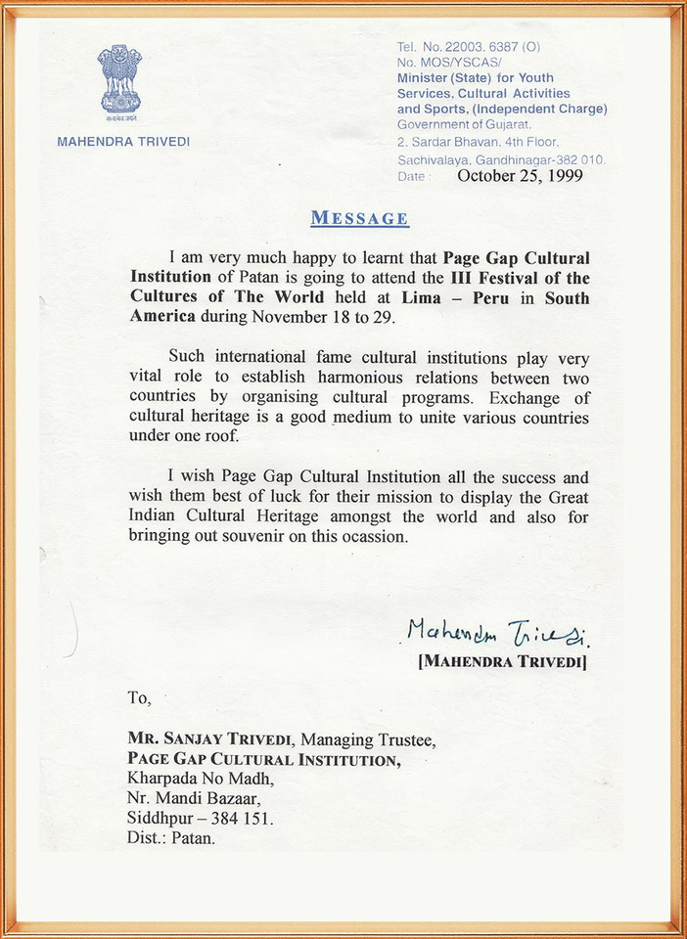
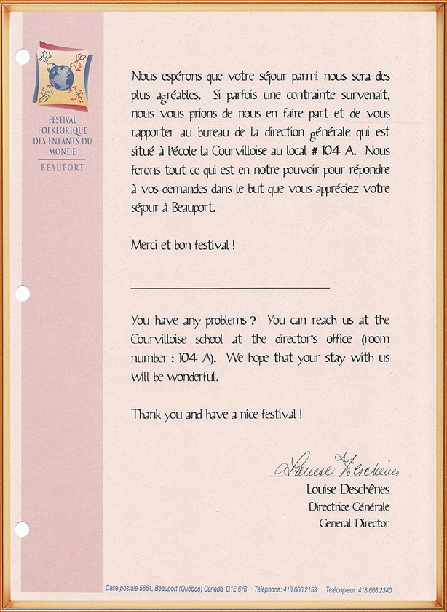
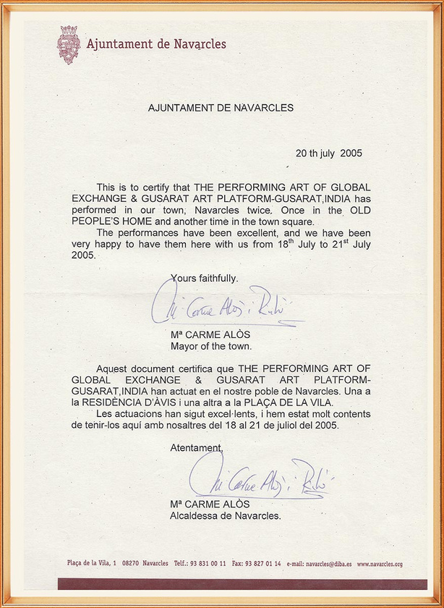
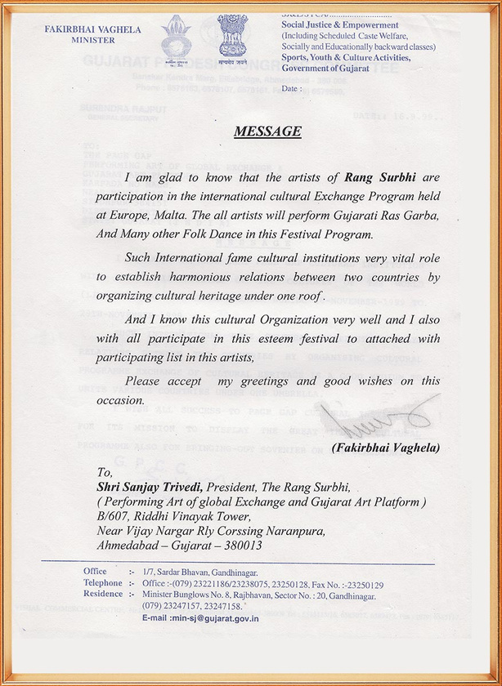

Slide 20
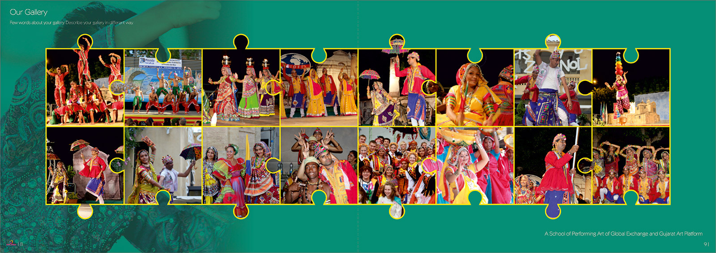

Slide 21
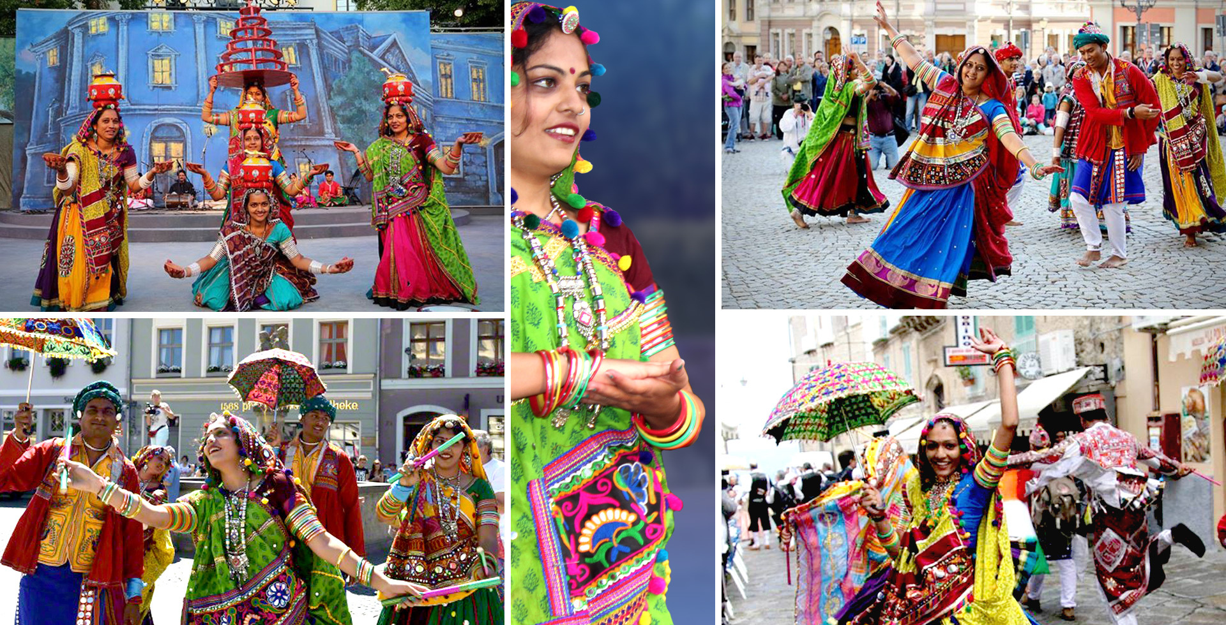

Slide 22
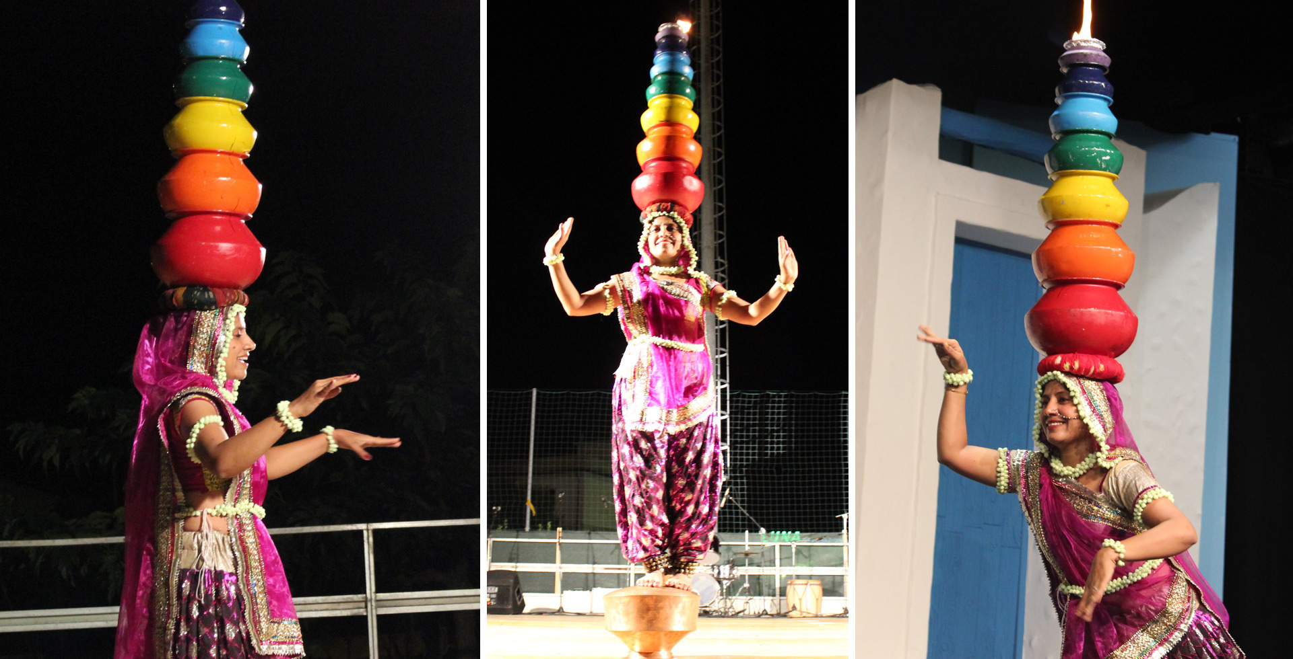

Slide 23
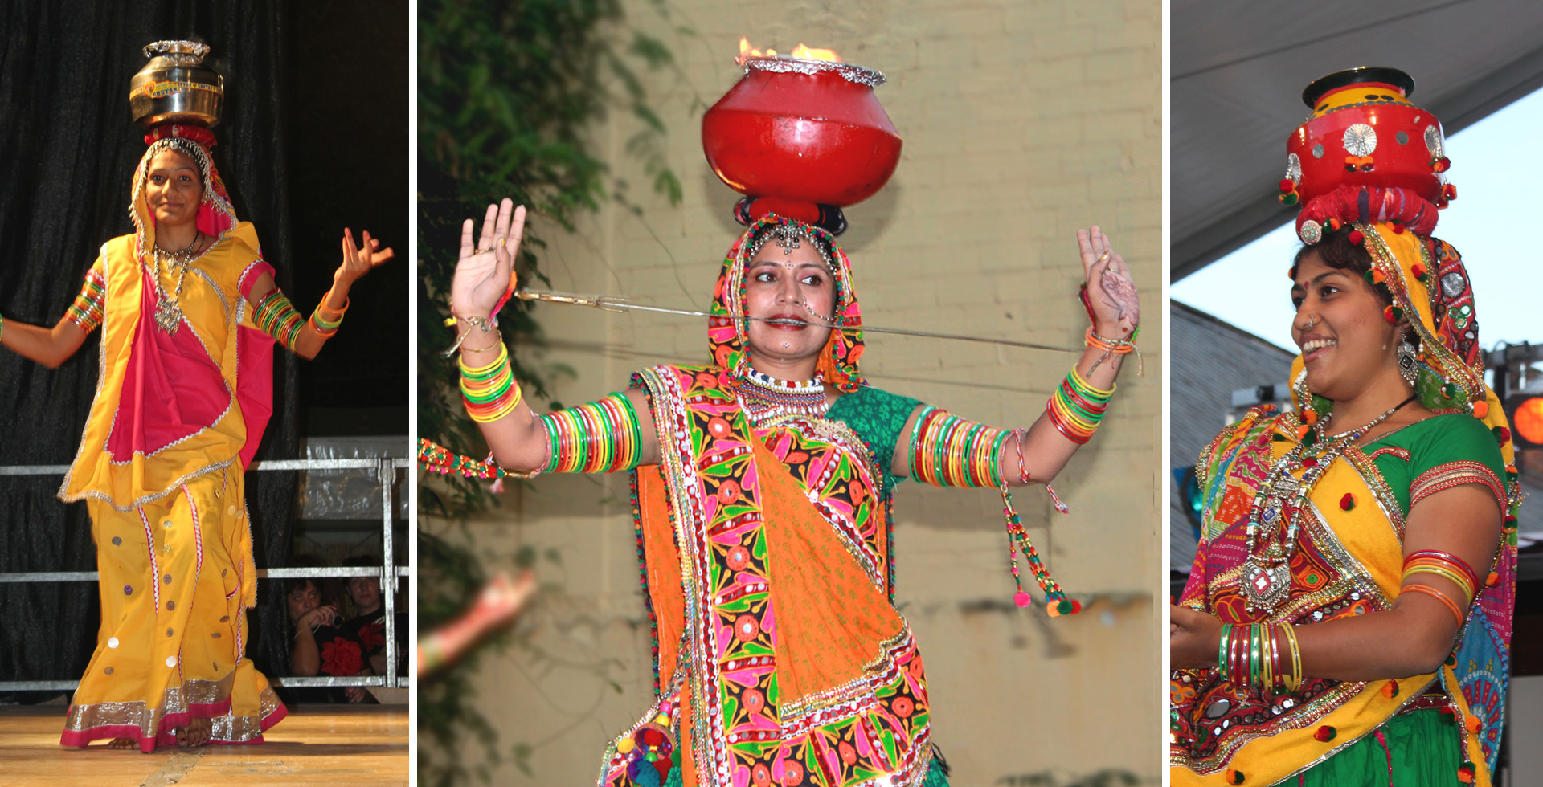

Slide 24
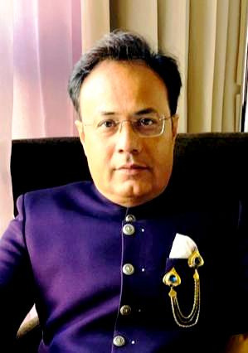
BOARD OF MEMBER
President
Sanjay Trivedi
Notes:
18

Slide 25



THANK YOU

